Slide 1
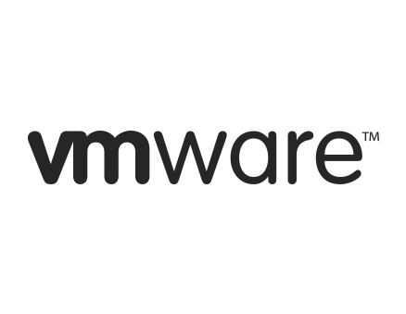
FIRMS AND SOLUTIONS: VMware
One of the first companies to add virtualization
Multiple fields like application and server virtualization are their area of expertise
Since 2005 provided for free development tools for virtualization
Free hypervisors to control their server
Products like Virtual San to datacenters and vCLoud

Slide 2
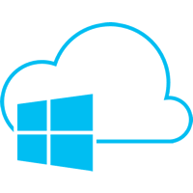

FIRMS AND SOLUTIONS: Microsoft
It is one of the biggest it companies
Focused on windows server and Azure
Their hypervisor is called Hyper-V
Servers are somehow compatible with windows

Slide 3

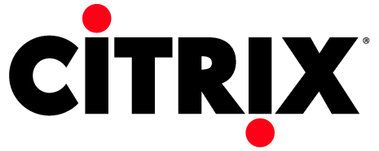
FIRMS AND SOLUTIONS: Citrix
One of the first developers on application virtualization
Provides services for server, networking
Nowadays owns Xen an open source software for virtualization services
Provided some services like XenApp and XenDesktop that add some features to Xen

Slide 4

FIRMS AND SOLUTIONS: Oracle
Owns Java, which works on JVM a remarkable example of good use of a virtual machine
Oracle provides some functionalities in case of Server and Desktop virtualization
Owner of virtual box an important program to create virtual machines
Virtual Box is widely used to access different OSs

Slide 5


FIRMS AND SOLUTIONS: Google
With all the amount of servers google uses virtualization is a basic utility for such a big company
They use Xen adapting it to their own necessities
They created Ganeti a cluster solution that manages xen hyoervisors to make administrator easier to create clusters

